Slide 1
CO456 Web - most materials adapted from Moseley (2007), Chapter 5 – supplemented with extracts from Bates (2006) and w3schools.com
Unit 6
JavaScript branches, loops & functions

Slide 2
Module schedule
Wk. | Lecture/subject area(s) | Practical | Reading (Moseley, 2007)
1 | Introduction How the Web works | Internet/Web definitions and HTML report | Ch 1 (The way the Web works)
2 | HTML 1 (Introductory - inc. lists and hyperlinks) | HTML | Ch 2 pp 24-36 (HTML)
3 | HTML 2 (inc. tables, images and forms) | HTML | Ch 2 pp 36-48 (HTML) Ch 3 (XHTML and frames)
4 | CSS 1 (Introduction and core CSS principles) | CSS – introductory styles, embedded styles. | Ch 4 pp 76-96.
5 | CSS 2 (Positioning elements). | CSS– using IDs, classes and layout control. | Ch 4 pp 97-103.
6 | CSS 3 (Advanced layout & navigation) | CSS – using CSS to produce button-like navigation from HTML list elements. (CW2a to be demonstrated). | Specialised articles.
7 | JavaScript 1 (Fundamentals, variables) | JS – foundation constructs. | Ch 5 pp 108-116
8 | JavaScript 2 (Functions, branches, loops). | JS – calling functions. | Ch 5 pp 117-124.
9 | JavaScript 3 (Objects and the DOM). | JS – manipulating the DOM. | Ch 6 126-139.
10 | JavaScript 4 (Forms and validation). And DHTML | JS– validating user completed forms. | Ch 6 139-145, Ch 7.
11 | HTML5, CSS3, - media, forms, gradients, SVG (‘Edge’) and other enhancements | Web frameworks taster session 1 | See practical sheets for information sources
12 | Advanced HTML5, CSS3 & JS frameworks (e.g. jQuery, jQuery Mobile, Box2DWeb) | Web frameworks taster session 2 | See practical sheets for information sources
 | Vacation
13 | Assignment workshop 1 | Assignment workshop 1 | N/A
14 | Assignment workshop 2 | Assignment workshop 2 | N/A

Slide 3
JavaScript - Branches
Three fundamental programming structures – sequence, selection (branches) and iteration loops
In JavaScript there are the following branching - selection statements:
if statement - use to execute some code only when one specified condition is true
if...else statement - use to execute code if the condition is true and to execute another code if the condition is false
if...else if....else “ladder” statement - use to execute different blocks of code if there are more than two conditions
switch statement – an alternative and more ‘condensed’ means of achieving “if...else if....else”
the “conditional operator” … var=(condition) ?value1:value2 (NOTE: this links to a short script on W3Schools that also demonstrates much about the DOM – definitely worth a closer look!!!)

Slide 4
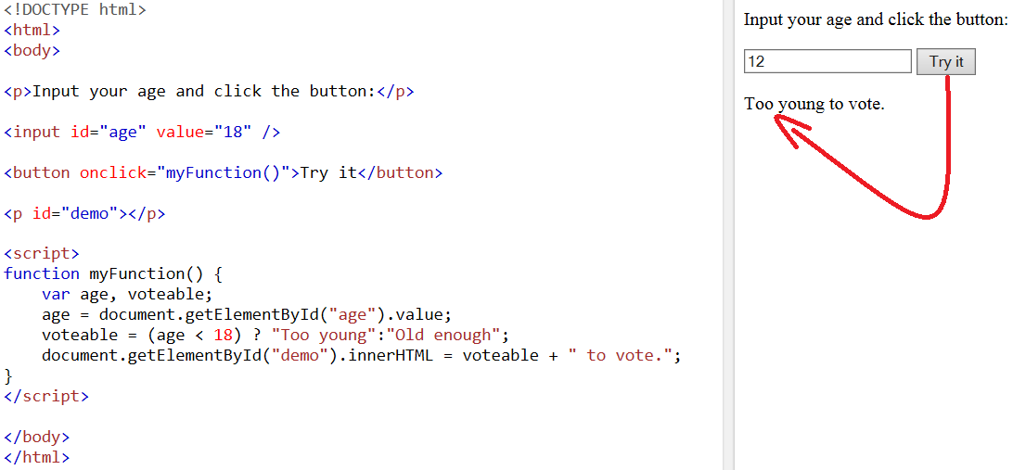
JavaScript – Branches short form using the conditional operator

Slide 5
JavaScript - Branches
Example of an “if - else if - else” ladder with the Date class
<script type="text/javascript">
var d = new Date()
var time = d.getHours()
if (time<12)
{
document.write("<b>Good morning</b>")
}
else if (time>=12 && time<18)
{
document.write("<b>Good afternoon</b>")
}
else
{
document.write("<b>Good evening</b>")
}
</script>

Slide 6
JavaScript - Branches
Example of a “switch” statement with the Date class
<script type="text/javascript"> //Greeting depends on what day it is - Note: Sunday=0,
var d=new Date(); theDay=d.getDay();
switch (theDay)
{
case 1: document.write("<h1><p style=\"color:blue; background:yellow; font-weight=bold\">Oh! ... Monday</p></h1>")
break
case 2: document.write("<h1><p style=\"color:blue; background:yellow; font-weight=bold\">Tuesday ... on a roll</p></h1>")
break
case 3: document.write("<h1><p style=\"color:blue; background:yellow; font-weight=bold\">Wednesday ... midweek already</p></h1>")
break
case 4: document.write("<h1><p style=\"color:blue; background:yellow; font-weight=bold\"> Thursday ... Nearly the w/e</p></h1>")
break
default:
document.write("<h1><p style=\"color:blue; background:yellow; font-weight=bold\">relax - the weekend! </p></h1>")
}
</script>

Slide 7
JavaScript - Branches
Example of the “conditional operator” with the Date class
Note: don’t forget to escape quotations in string variables!
<script type="text/javascript"> //Rule ... var=(condition) ?value1:value2
var d=new Date();
theMonth=d.getMonth(); //Months are numbered 0 to 11
season=(theMonth>=9 || theMonth<=2) ?
"<p style=\"color:white; background:blue; font-weight=bold\">winter</p>"
:
"<p style=\"color:red; background:orange; font-weight=bold\">summer</p>"
document.write("It must be " + season);
</script>

Slide 8
JavaScript – Iteration (loops)
Allow iteration/repetition of sections of code
Three types of loops – “for”, “while” and “do while”
For loop:
rule: for(start value; limiting condition; increment)
counter (e.g. “i”) may also be used to process contents of an array
e.g. for(i=0; i<=3; i++) { document.write(myArray[i]); }
While loop:
must declare and initialise counter first (e.g. “count”)
e.g. count = 0; while (i<=3) { document.write(myArray[i]) ; i++; }
Do while loop
again, must declare and initialise counter first (e.g. “count”)
tests condition after loop so will always execute at least once
e.g. count = 0; { document.write(myArray[i]) ; i++; } while (i<=3)

Slide 9
JavaScript – Functions
Separate from the main program
Principle of “write once use many”
Advantages to breaking a program up into discrete subroutines include:
reducing the duplication of code in a program
enabling reuse of code across multiple programs,
decomposing complex problems into simpler pieces (improves maintainability and ease of upgrade)
improving readability of a program
hiding or regulating part of the program (see “Information hiding”)
The components of a subroutine include:
always - a body of code to be executed when the subroutine [function] is called
sometimes - parameters that are passed to the subroutine from the point where it is called
sometimes - a value that is returned to the point where the call occurs [
remember: returned values may be capture by a variable. For example, to capture a value returned by JavaScript confirm/prompt box … var c=confirm("Select one ...")

Slide 10
JavaScript – Functions
Functions contain code that is executed either by an event or by a call to the function.
Functions are often defined in the <head> section.
<html>
<head>
<script type="text/javascript">
function displaymessage() //This is only executed by the “onclick” event of the form below
{ alert("Hello World#2! – \n\n\tthis alert box\n\tis placed \n\tinside a \n\tfunction!") }
</script>
</head>
<body>
<form><input type="button" value="Click me!" onclick="displaymessage()" ></form>
<script type="text/javascript">
alert("Hello World #1! – \n\n\tthis alert box\n\tisn’t in a \n\tfunction!") //Not a function - executed on page load
</script>
</body>
</html>
[1] alert("Hello World #1!") is executed as soon as the page is loaded.
[2] alert("Hello World #1!") is only executed by the onClick event which calls the function displaymessage() when the button is clicked by a user.

Slide 11
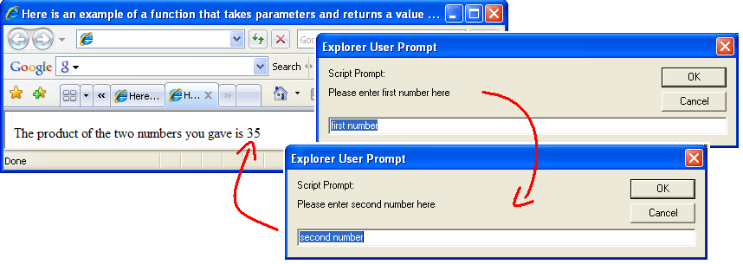
JavaScript – Functions
Here is an example of a function that takes parameters and returns a value
<html>
<head>
<script type="text/javascript">
function product(a,b)
{
return a*b
}
</script>
</head>
<body>
<script type="text/javascript">
var value1=prompt("Please enter first number here","first number")
var value2=prompt("Please enter second number here","second number")
document.write("The product of the two numbers you gave is " + product(value1,value2))
</script>
</html>
3
4
1
2

Slide 12
An iterator function Adapted from: https://developer.mozilla.org/en-US/docs/Web/JavaScript/Guide/Iterators_and_Generators
“An object is an iterator when it knows how to access items from a collection one at a time, while keeping track of its current position within that sequence”
“In JavaScript an iterator is an object that provides a next() method which returns the next item in the sequence. This method returns an object with two properties: done and value”
“Once created, an iterator object can be used explicitly by repeatedly calling next()”

Slide 13
An iterator function (continued) Adapted from: https://developer.mozilla.org/en-US/docs/Web/JavaScript/Guide/Iterators_and_Generators
To understand the following example note that:
Colons “:” are used in JavaScript and many c-based languages as the delimiter for a key:value pair. For example we have just seen this in CSS- e.g.
h1 { color : red ; font : italic 10em Times, serif; text-decoration: underline; background: black; }
Colons are also used as “Object Literal” notation. A JavaScript object literal is (like CSS) a comma-separated list of name-value pairs wrapped in a code block.
See example on next slide …

Slide 14
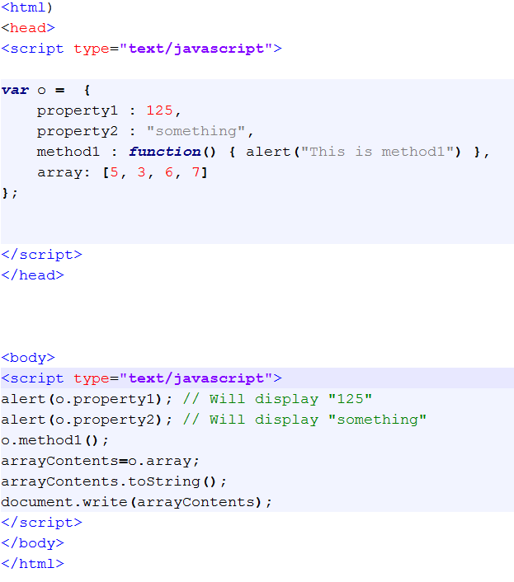
Object literal example

Slide 15
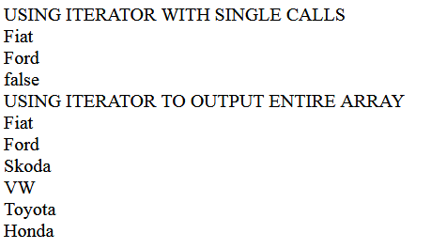
An iterator function (continued) Adapted from: https://developer.mozilla.org/en-US/docs/Web/JavaScript/Guide/Iterators_and_Generators
function makeIterator(array){
var nextIndex = 0;
return {
next: function(){
return nextIndex < array.length ?
{value: array[nextIndex++], done: false} :
{done: true};
}
}
}
###############################################
document.write("USING ITERATOR WITH SINGLE CALLS<br/>");
var it = makeIterator(['Fiat', 'Ford', 'Skoda','VW','Toyota','Honda']);
document.write(it.next().value+'<br/>'); // 'first value'
document.write(it.next().value+'<br/>'); // 'second value'
document.write(it.next().done+'<br/>'); // true only if at end of array

Slide 16
JavaScript summary
JavaScript provides “normal” programming facilities for implementing sequence, selection and iteration using “familiar” C-language syntax
JavaScript provides many internal functions (including readymade pop up ones - alert, prompt, confirm) and allows developers to write their own
Functions allow repeatable, reusable code to be separated so that it may be executed by events/calls
Placing functions in the <head> element ensures that they are read and loaded by browser before being called by some event
The basic “C-like” syntax for defining a function is …
function functionName(parameter1, ...,parameterX) { some code; return someVariable (optional); }
Can write an iterator that remembers where it is in an array of items
NEXT WEEK – JavaScript objects and the Document Object Model

Slide 17
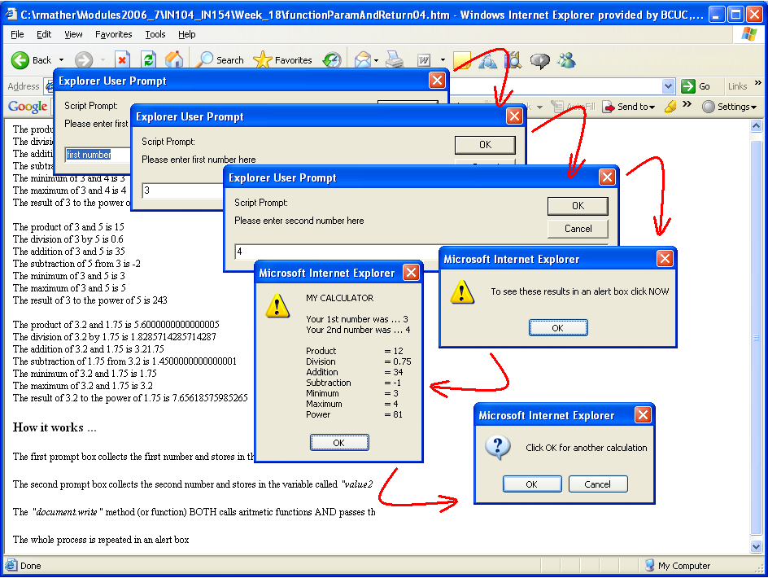
Practical 6
Work towards assignment 2a
Rewrite last week’s JS solution using loops, functions and the Array.length property
Produce a simple popup driven calculator with interface similar to the one below
Complete the ‘iterator’

